Slide 1

Augmented Reality Technique for Reducing Overfishing
Prepared By
Mohammad Abu-Shaira
Mahee Tayba
Amr El-Sayed

Slide 2
Augmented Fishing Prototype
•Traditional Fishing is a kind of a sport which is highly regulated because of concerns related to:
•Fishing Wealth.
•Overfishing
•Wrong Fishing Practices.
•Also has other concerns:
•The fishermen connection to the underwater environment is diminished.

Slide 3
What’s the problem that we are solving?
• In our research paper we are trying to reduce inadvertent overfishing by giving more information letting fishermen abide with rules and regulations and avoid overfishing and wrong fishing practices.
•Textual information about different underwater fishes:
•Species
Family
Age
Fishing Season
Current Size
Area of availability

Slide 4
What’s the research question?
•How Augmented Reality can help in eliminating or reducing problems related to fishing wealth as overfishing?
•How Augmented fishing can allow fishermen abide with fishing rules and regulations related to fishing season and age of the fish? Regulatory to Monitor.

Slide 5
Who are the users?
•Fishermen professionals who practice their sport in a professional way and abide with rules and regulations.

Slide 6
How are we accomplishing this?
•We introduce Augmented Fishing:
•Augmented Fishing is basically the use of a Fishing Rod that is supplied with a screen/smart device like phone and an underwater camera.
•Camera (Under Water):
•Will explore species under water.
•Screen/Phone:
•The screen will work with a classification algorithm for fish species
•The screen show a live image of what is going on under the water.
•The screen will provide with a textual information about fishes under water.
•The screen will give pulses for good fishing areas for fishermen preferences and season.

Slide 7
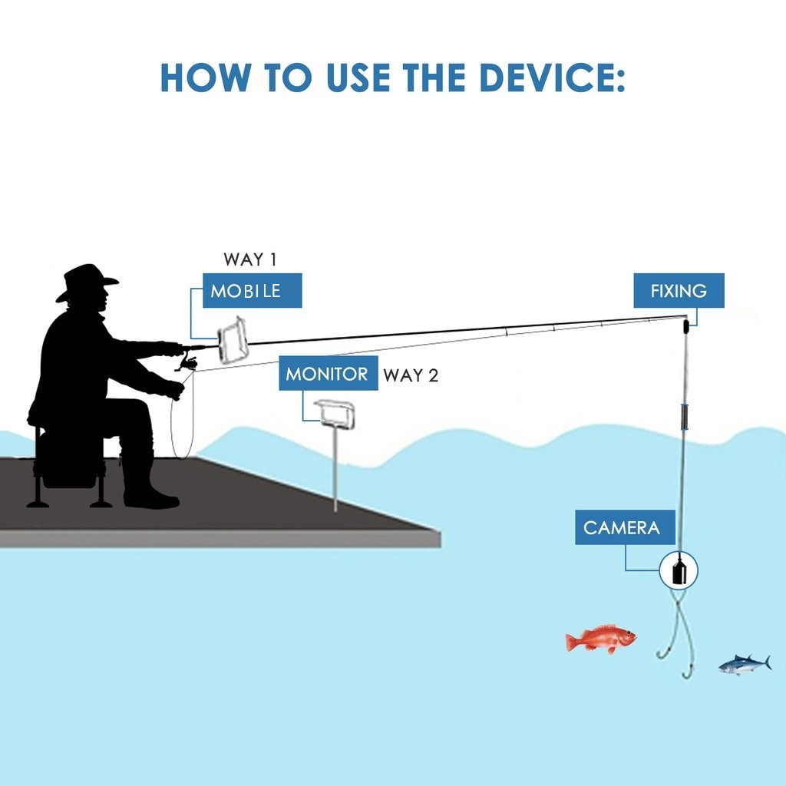
Augmented Fishing Prototype

Slide 8
Augmented Fishing Prototype
Above in Figure 1.0 showing our prototype for Augmented Fishing for overcoming issues related to overfishing.
The overall prototype consists of
A Monitor
A Camera.
And the normal fishing rod used by fishermen.
The user has the option to use a mobile device or a smart monitor.

Slide 9
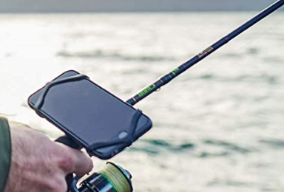
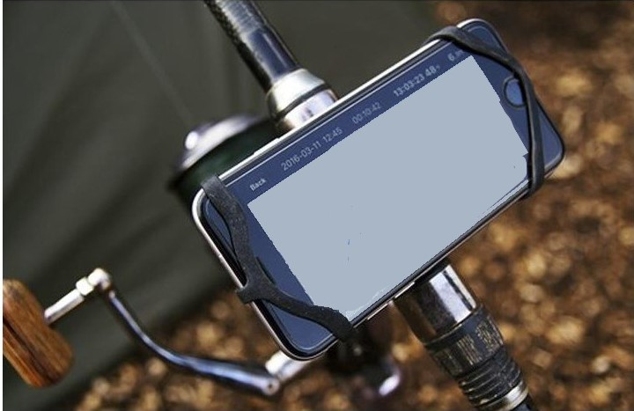
Augmented Fishing Prototype
The above Fig 2.0, 2.1 showing a mobile device connected to a fishing rod.

Slide 10
Usability Concern
The monitor may vary in sizes and weights and its attachment to the fishing rod might affect usability and the ability of the fishermen to through the rod into the water
So we have added the ability to place the monitor on solid surface like a table or the ground.

Slide 11
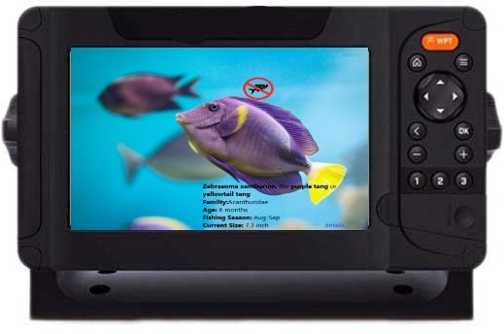
Augmented Fishing Prototype
The above Fig 3.0 shows a monitor stands on the ground connected to the fishing rod.

Slide 12
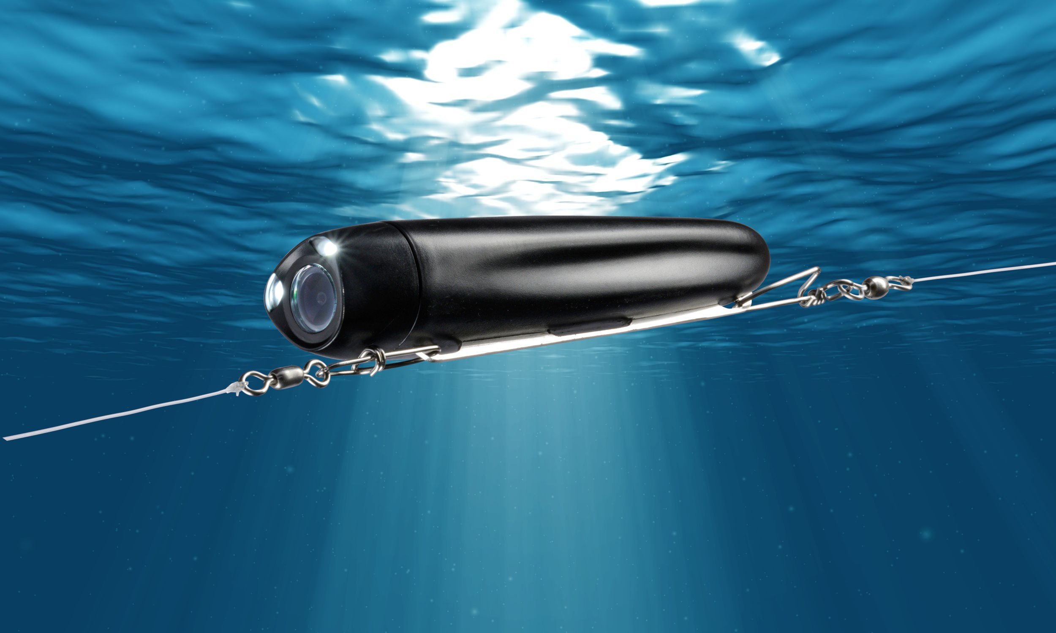
Augmented Fishing Prototype
The above Fig 4.0 showing a camera under the water connected to the fishing string.

Slide 13
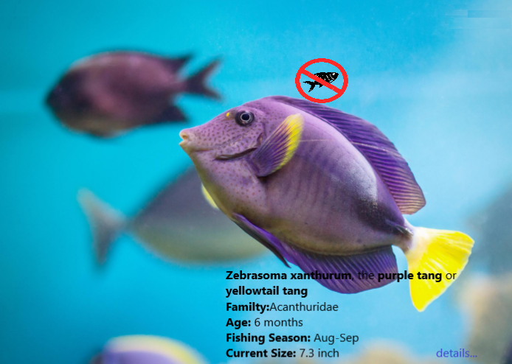
Augmented Fishing Prototype
The above Fig 5.0 showing a textual representation of a fish basic info, also showing a prohibited fish for any reason could be the area of fishing, the size, the age, the type

Slide 14
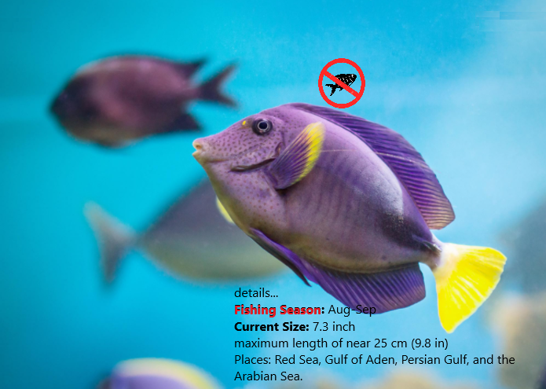
Augmented Fishing Prototype
The above Fig 6.0 showing a prohibited fish, and details showing the main reason to be a prohibited fish and other specific fish details.

Slide 15

Augmented Fishing Prototype

Slide 16
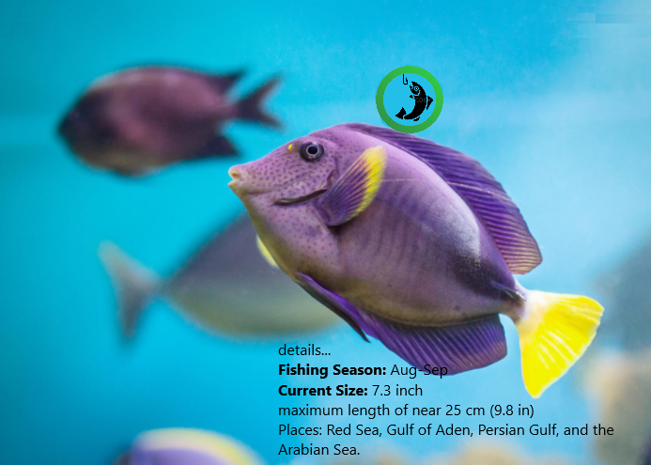
Augmented Fishing Prototype

Slide 17
Participants
Thirty paid participants participated in the study. They were divided
into two groups:
The first one consisted of twenty professional fishermen with 5 - 10 years of experience in fishing.
The other one had ten fishing practitioners with 10 - 15 previous fishing activities.
Their average age was 30 years with standard deviation of 10.5.
In addition to a control group consisted of five men from the regularity parties were recruited to monitor and control the procedure correctness and validation.

Slide 18
Procedure
The procedure was conducted through two different groups of
Participants:
G1 had the professional fishermen.
G2 included the fishing practitioners.
The experiments were video recorded.
Fishing area and time were considered constant during the experiments.
The overfishing rate was calculated through the number of wrong fishing for prohibited fishes divided by the total number of fished fishes during the experiment.
For this reason, a control group of five men from the regularity parties were recruited to monitor and measure the overfishing rate per group.

Slide 19
Study-1
In this study we focused on how the professionality level influenced the overfishing rate.
G1 and G2 were asked to start their fishing activity using the traditional way.
After that, the overfishing rate was measured per group.

Slide 20
Study-2
This study introduced the augmented fishing technique and materials
to be used by the fishermen.
G1 and G2 were directed to check the mentioned apparatus, such that each individual fisherman could try it freely for 30 minutes without any instructions.
After that, one hour session was held to answer the most relevant questions and inquiries that may affect their fishing experience during the experiment.

Slide 21
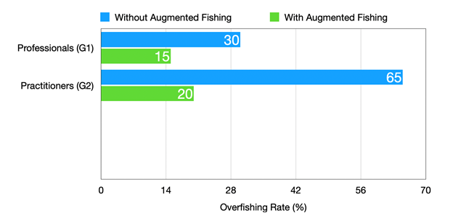
Results
G1 overfishing rate decreased in study 2 with the half of its previous value to be 15% instead of 30%.
While the huge edge was derived from G2 which reached to 20% to be nearly the same as the professional group rate.

Slide 22
Conclusion
The experiment showed that the usage of augmented fishing technique
Increased the professionalism level of a fisherman.
And eventually decreasing the overfishing rate.
The usage of augmented fishing had a great positive effect on decreasing the overfishing rate.

Slide 23
Thank You

